Slide 1
Wenxin Zhou
Travel in Water Town

Slide 2

Inspiration

Slide 3
Model
Every model started out as a cube or plane
Import models to OpenGL using Assimp
Carefully scaling, tilting and positioning the objects

Slide 4
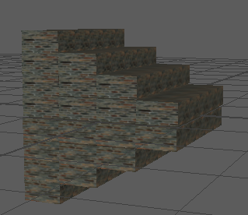
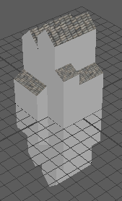
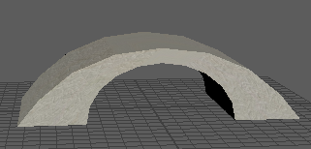
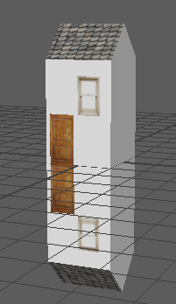
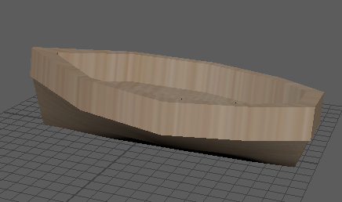

Slide 5
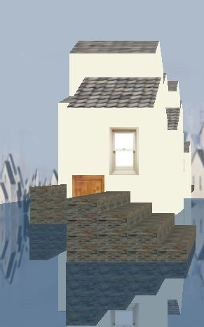
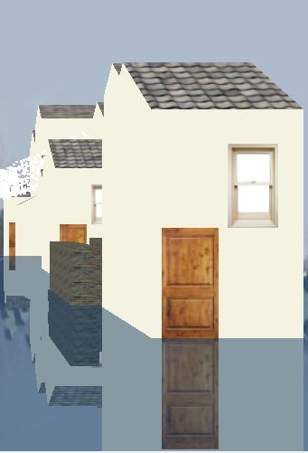
Reflection

Slide 6
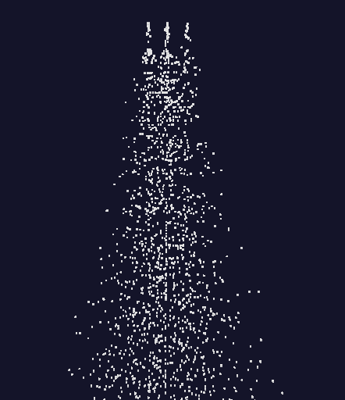


Particle System

Slide 7
sources
Assimp
https://learnopengl.com/#!Model-Loading/Assimp
Model Loading
https://github.com/SonarSystems/Modern-OpenGL-Tutorials/tree/master/%5BMODEL%20LOADING%5D
Particle system
http://www.swiftless.com/tutorials/opengl/particles.html
Boat Model
https://www.youtube.com/watch?v=5aI2nmC_TTs

